Slide 1



Transformation through Collaboration
Driving Change Together

Slide 2

Agenda
Why are we undertaking this work?
Discovery Project
Models & Principles of Collaboration
What is being proposed - Tranche 1
Next steps

Slide 3

Why are we undertaking this work?
National Context
Public Sector Reform
Solace/Improvement Service Work
Local Context
Financial Sustainability
Current 5 Year Gap - £43.9m
Current 5 Year Gap Net of Savings Options - £27.9m
Target Operating Model
Transformation Programme

Slide 4
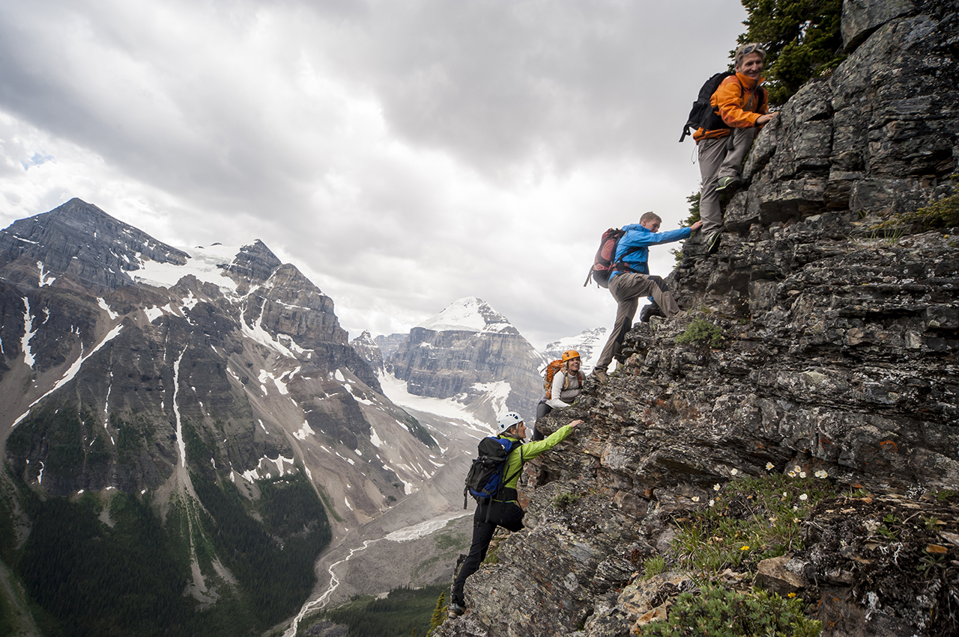
Discovery Project
Partner Councils with External Support
Purpose of Discovery Project
What it doesn’t cover
Who was involved
How was it done:
Data review
Workshops on current arrangements
Workshops on potential opportunities
External subject specialist input

Slide 5

Principles for collaboration
Scalable
Significant
Flexible and form agnostic
Proven outcomes for communities
Strategically aligned
Sustainable
Transformative and ambitious
Fair and equitable

Slide 6
Models of Collaboration
Model | Description
Self-Sustaining Model | Uses existing Transformation Programme, and builds on this internally with further transformation options
Mixed Economy | Joint partner activity, such as sharing of roles, commissioning, standardising without combining resources
Integrated Model | Fully embeds and combines delivery functions that serve the needs of partners with resources integrated

Slide 7


Assessment of Models
Model | Description | Conclusion
Self-Sustaining Model | Transformation will continue but level of change and savings not sufficient if limited to one Council | Not viable in longer term
Mixed Economy | Some benefits but does not provide clear, cohesive and consistent change or sufficient return on investment | Does not meet level of benefits required
Integrated Model | Provides a sustainable return on investment as well as headroom to redirect resources | Highest benefit and longer-term scalability

Slide 8

Proof of Concept
To identify Projects consideration was given to:
Principles for collaboration
Potential for significant financial benefits
Potential for service improvements
Service sustainability
Impact on communities
Likelihood to success and scalability
Investment required v benefits
Funding through Invest to Save Fund

Slide 9

Tranche 1 - Falkirk & Clackmannanshire only
Development & Design to Business Case:
Support for ASN Services
Internal Audit & Fraud
Revenue & Benefit Services
Development Phase prior to Full Business Case
Housing services
Roads
Estates Management

Slide 10
Tranche 1 - Regional / Regional+
Development & Design to Business Case:
Council
Joint Procurement & Contracting of IT for Education
Resilience & Emergency Planning
Regulatory Services: Trading Standards, Building Standards, Environmental Health
Economic Development
Employability
Corporate Procurement
HSCP
Social Care: Front Door Provision, Contact Centre, Case Management, Financial Assessments, Service User Charges and Income Policies (and Automation)
Opportunities for C&F Joint Commissioning
Shared Business Processes for C&F, Adults and Criminal Justice
Potential for Joint Foster Care Work
Storage & Maintenance of Equipment - JLES & Education

Slide 11
Tranche 1 - Wider Collaboration
Regional/Regional+ with Other Sector Partners
Asset Strategy
Funding through Invest to Save Fund
HR & Payroll Services

Slide 12

Supporting the Change
Governance Models
Financial Modelling & Planning
Workforce Planning
Streamlining Systems and Processes
Communication, Engagement and Consultation Plans

Slide 13

Next Steps Subject to member approval in both Councils
Establishment of Officer Programme Board
Representation from both Councils and scope to increase as appropriate
Appointment of Lead Officers (Internal & External) for
All Tranche 1 Functions or Groupings of Functions
Overarching workstreams - Governance, Workforce, Legal, IT, Communications
Draw down of Scottish Government Invest to Save Funding
Establishment of Work Plans and Timelines
Stakeholder Communication and Engagement
Partners, Employees, Trade Unions and Other Stakeholders
Reporting to Council at appropriate milestones

Slide 14

Questions
QUESTIONS?

